Slide 1
Edge Analytics & Logging Bootcamp
Logging

Slide 2
Edge Logging Services
One of the best ways to track issues, problems is through log messages.
To log custom messages to disk (Private Cloud) or to Syslog, you can use the Message Logging policy.
File logging is supported only in Edge for Private Cloud deployments. It's not available in Edge cloud. However, Syslog is available in both Edge Cloud and Edge for Private Cloud.
The different options available are:
Syslog
Syslog (over TLS)
File Rotation - time, size, both

Slide 3
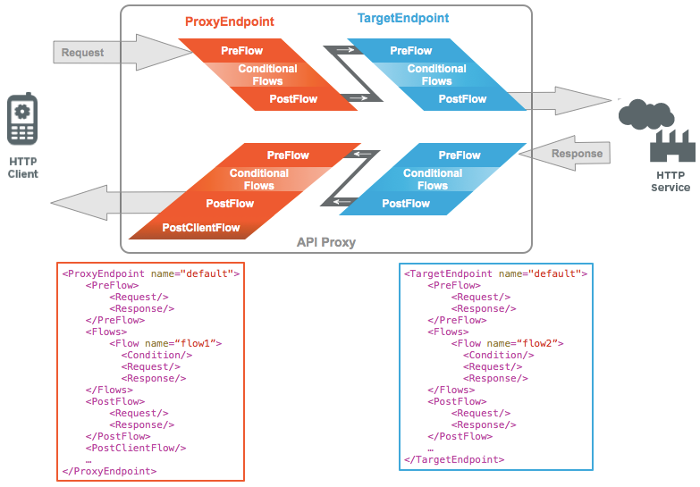
Edge Logging Services
Consider placing the policy in the ProxyEndpoint response, in a special flow called PostClientFlow.
The PostClientFlow executes after the response is sent to the requesting client, which ensures that all metrics are available for logging and does not impact the response time to the client.

Slide 4
Edge Logging Services
The Message Logging policy lets you send syslog messages to third-party log management services
Some of the log management service providers are:
Splunk
Sumo Logic
Loggly
Stackdriver
You can find all the above integrations on Apigee community

Slide 5
Message Logging Policy
<MessageLogging name="LogToSyslog"> <Syslog> <Message>[3f509b58 tag="{organization.name}.{apiproxy.name}.{environment.name}"] Weather request for WOEID {request.queryparam.w}.</Message> <Host>logs-01.loggly.com</Host> <Port>514</Port> <Protocol>TCP</Protocol> <FormatMessage>true</FormatMessage> </Syslog> <logLevel>ALERT</logLevel> </MessageLogging>

Slide 6
THANK YOU

